Slide 1



Netra

Slide 2
Organization Name : Dte of IT & Cyber Security, DRDO
College Name : University of Petroleum and Energy Studies, Dehradun
Team Name : ALPHA PROCESSORS
Team Members : Aviral Srivastava, Sachin Agrawal, Dhairya, Priya Prakash, Suhaan Pinapala

Slide 3
Objectives
Creating an extra layer of security and authentication in highly classified organizations by upgrading the existing surveillance system through AI enabled software.
To use Artificial Intelligence for real-time monitoring of the video footage with intelligent analysis of how malicious activities can possibly occur and implementing proper methods for preventing them
To create a “Video based dynamic human authentication system”, by analyzing the movements and postures of the individuals and comparing them with the recorded dataset.

Slide 4
Implementation
The existing data set is stored on the AWS cloud service platform for training our Model which will used by our software.
The existing data set will also be continuously modified by the photos/videos provided by the company over time.
The AI enabled software will identify the individuals by using the initial authentication process by calculating the distances and angles between predicted points on the body.
When an unauthorized entity requires access permissions, it generates a ticket for the administrative layer of our security system.

Slide 5
System Users will look after the software under observation to ensure its proper functioning.
The development layer is responsible for the regular updation and debugging of our software
The real time data received from the nodes will be stored separately and will be used for further analysis and enhancement of our data set.

Slide 6

Security Architecture Diagram
End User Layer
System Layer
Administrative Layer
Development Layer

Slide 7
Outcomes
Our AI enabled Surveillance System “NETRA”, would act as a more reliable security shield, as it is completely self sufficient.
The system thus created would solve the problem of keeping track of unauthorized access.
Malicious activities as well as infiltrators can be detected with much more precision preventing threats at the earliest.
We are able to refine the dataset as the system is used over some time.

Slide 8
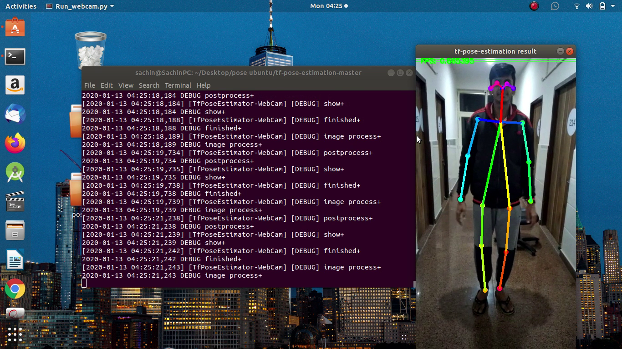
Insert screenshots of MVP

Slide 9
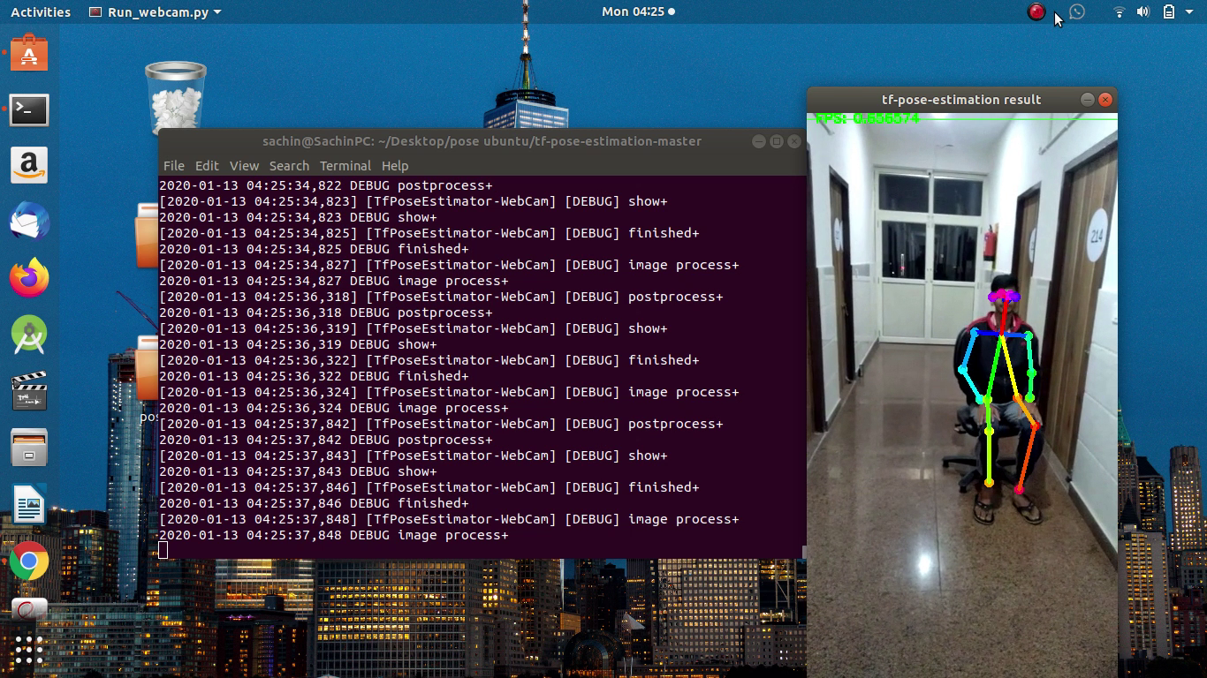

Slide 10
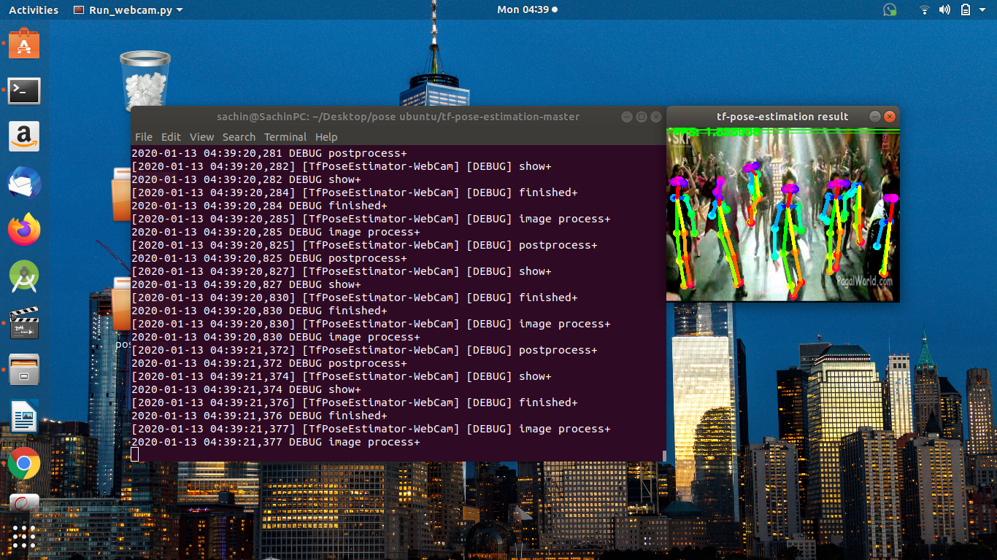

Slide 11
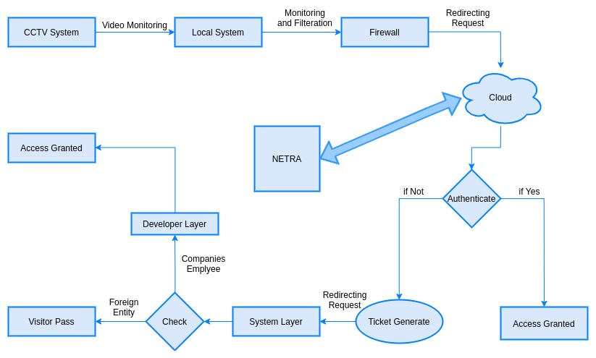

Data Flow Diagram

Slide 12
Use Cases
Security & Authentication:
Home Surveillance: The AI based Surveillance cameras can be set up in residential areas as well as individual houses. These camera will monitor the surroundings and will be analyzing activities for discovering potential threats.
Defense: Implementing AI Surveillance cameras in military technologies can create much better tactical inventory. Such as AI based drones will be able to detect threats, by analyzing different areas for any suspicious sights.

Slide 13
Video based Human Authentication System
Can be used as in Residential Home Surveillance
Can be used as in Industry Storage Surveillance
Can be used as in Employee Attendance System
Can be used as in Intrusion Alert System
Vision Enabled Video Based Drone Surveillance
Military Surveillance with decision making capabilities
Economic benefits by lesser use of security equipment.

Slide 14
Requirements
9 axis accelerometer as a sensor with a microcontroller
CCTV installation kit
Enterprise edition system with minimum 8GB RAM and NVIDIA graphics card.
Amazon Web Services as our cloud computing platform
Tensorflow.js, ML5.js and P5.js libraries, PoseNet as pre-trained dataset and Visual Studio Code Enterprise Edition as IDE.

Slide 15
Thank You!

